Slide 1
Nno
NEWSLETTER OCTOBER 2022
EDUCATION IS THE MOST POWERFUL WEAPON WHICH YOU CAN USE TO CHANGE THE WORLD.
WINNERS OF BEST OUT OF WASTE COMPETITION
NURSERY
1ST AKSHAN AND ALIKHA.A
2ND YUVAN SHARMA
3RD ASHWANYA AND LAVANYA TAMTA
K.G
1ST RISHITA SINGH AND AARVI PURAN
2ND ADHIRA SHARMA
3RD HARSH JIMIWAL

Slide 2
Nno
WINNERS OF
ENGLISH RECITATION COMPETITION
NURSERY
1ST IBHAN KUMAR
2ND AANYA CHAUDHARY AND ASHWANYA
3RD YUVAN SHARMA
consOLATION : ALIYU AND HARDIK AND YASHAVI MEENA
K.G
1ST AARVI PURAN AND ADHIRA SHARMA
2ND SUYASH VERMA and RISHITA SINGH AND FERIT
3rd Akshita sharma and advik and viraj singh
CONSOLATION :TANSHIK AND AKIRA AND AYAN ALI

Slide 3
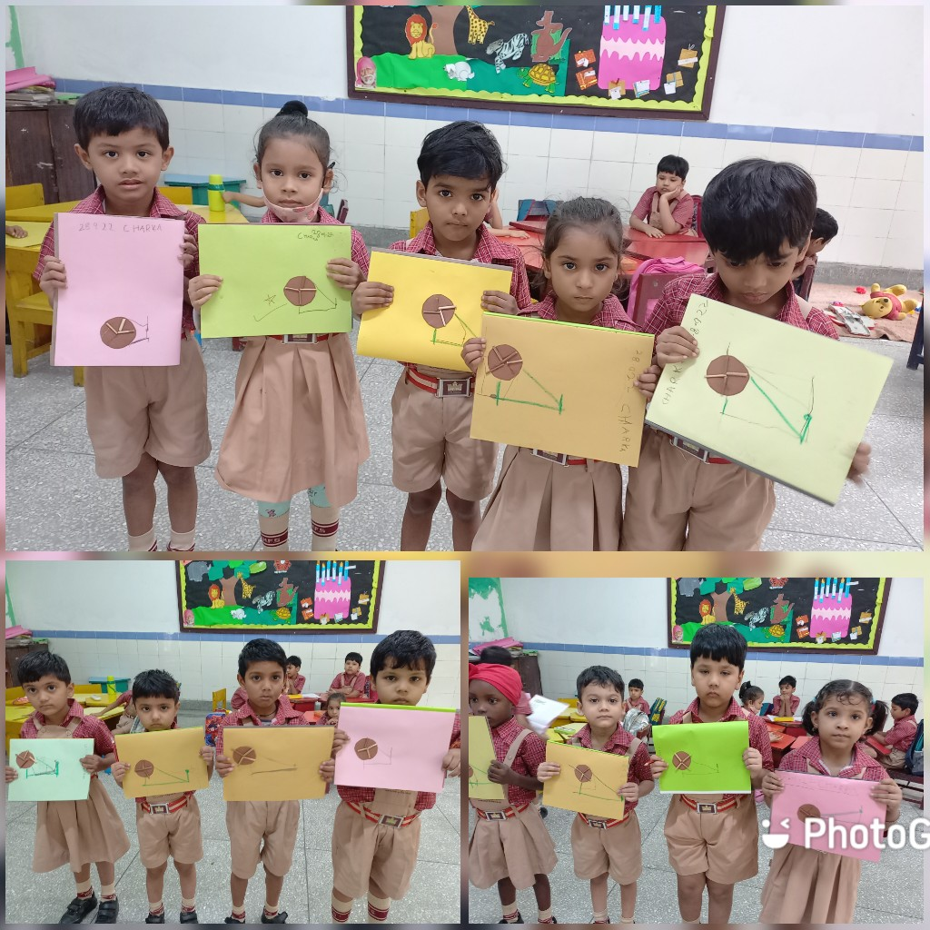
Nno
GANDHI JAYANTI ACTIVITY
YOU MUST BE THE CHANGE YOU
WISH TO SEE IN THE WORLD

Slide 4
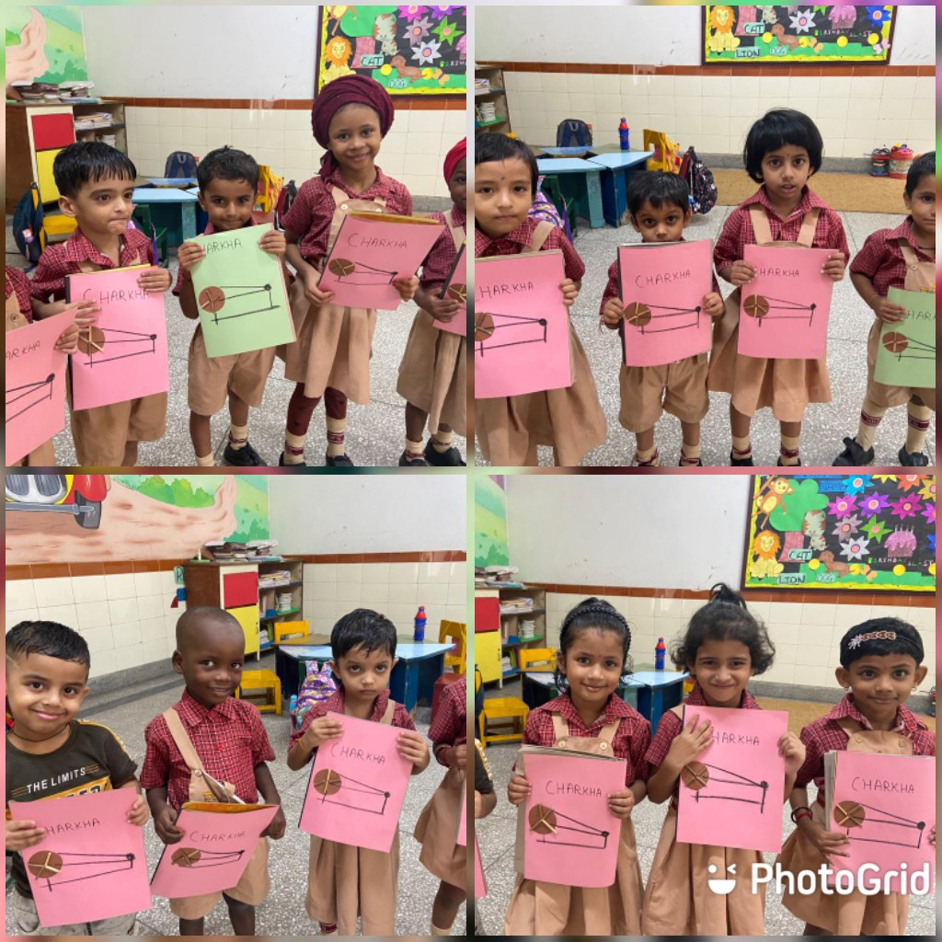
S
.

Slide 5
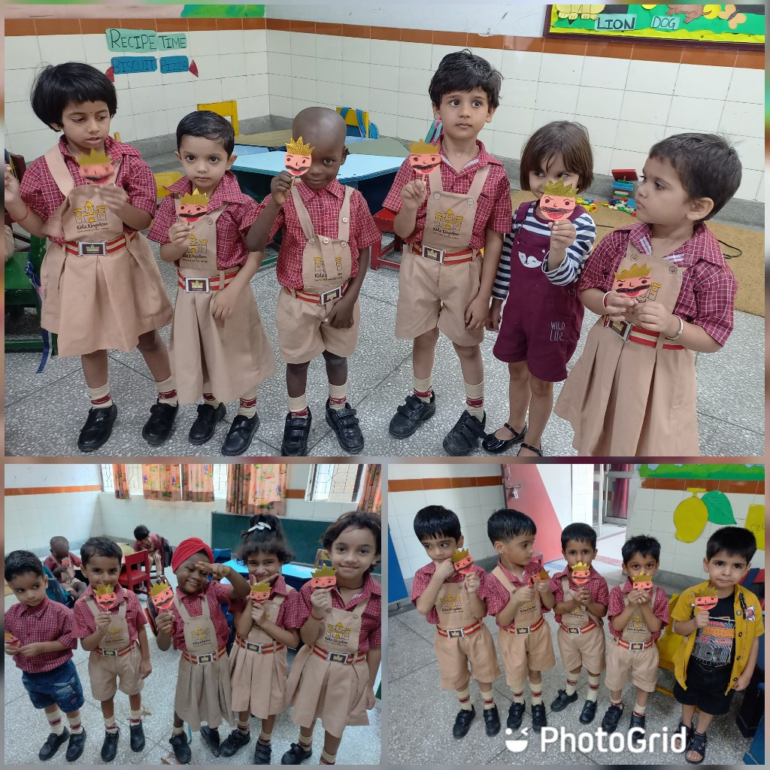
S
DUSSHERA CRAFT ACTIVITY
MAY THE VICTORY OF GOOD OVER EVIL INSPIRE YOU TOWARDS YOURS
.

Slide 6
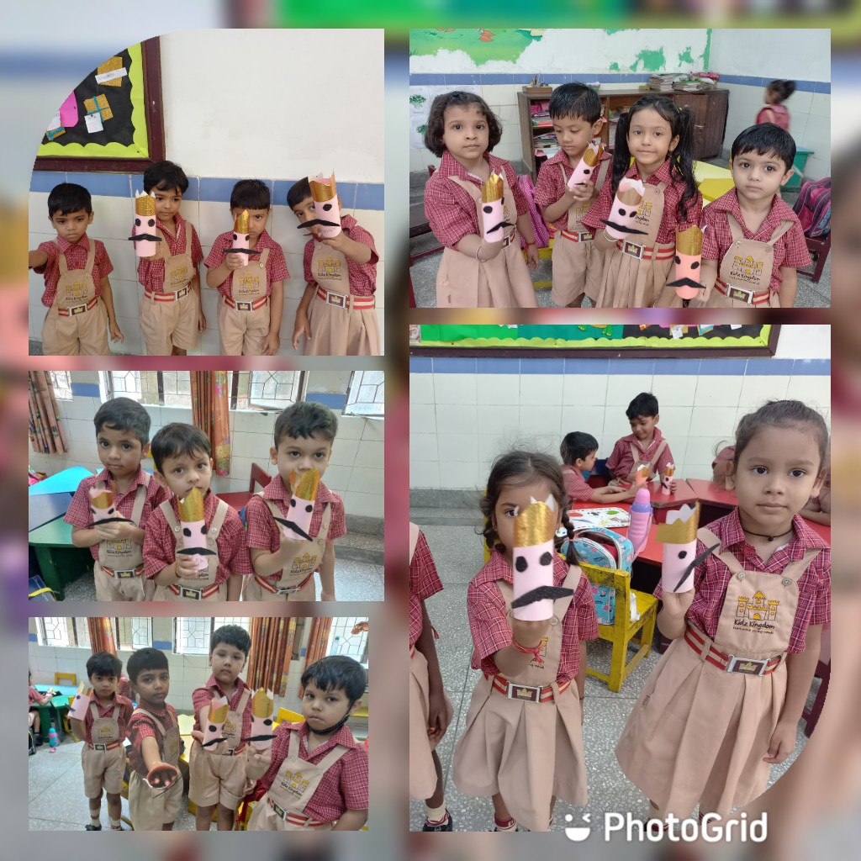
S
.

Slide 7
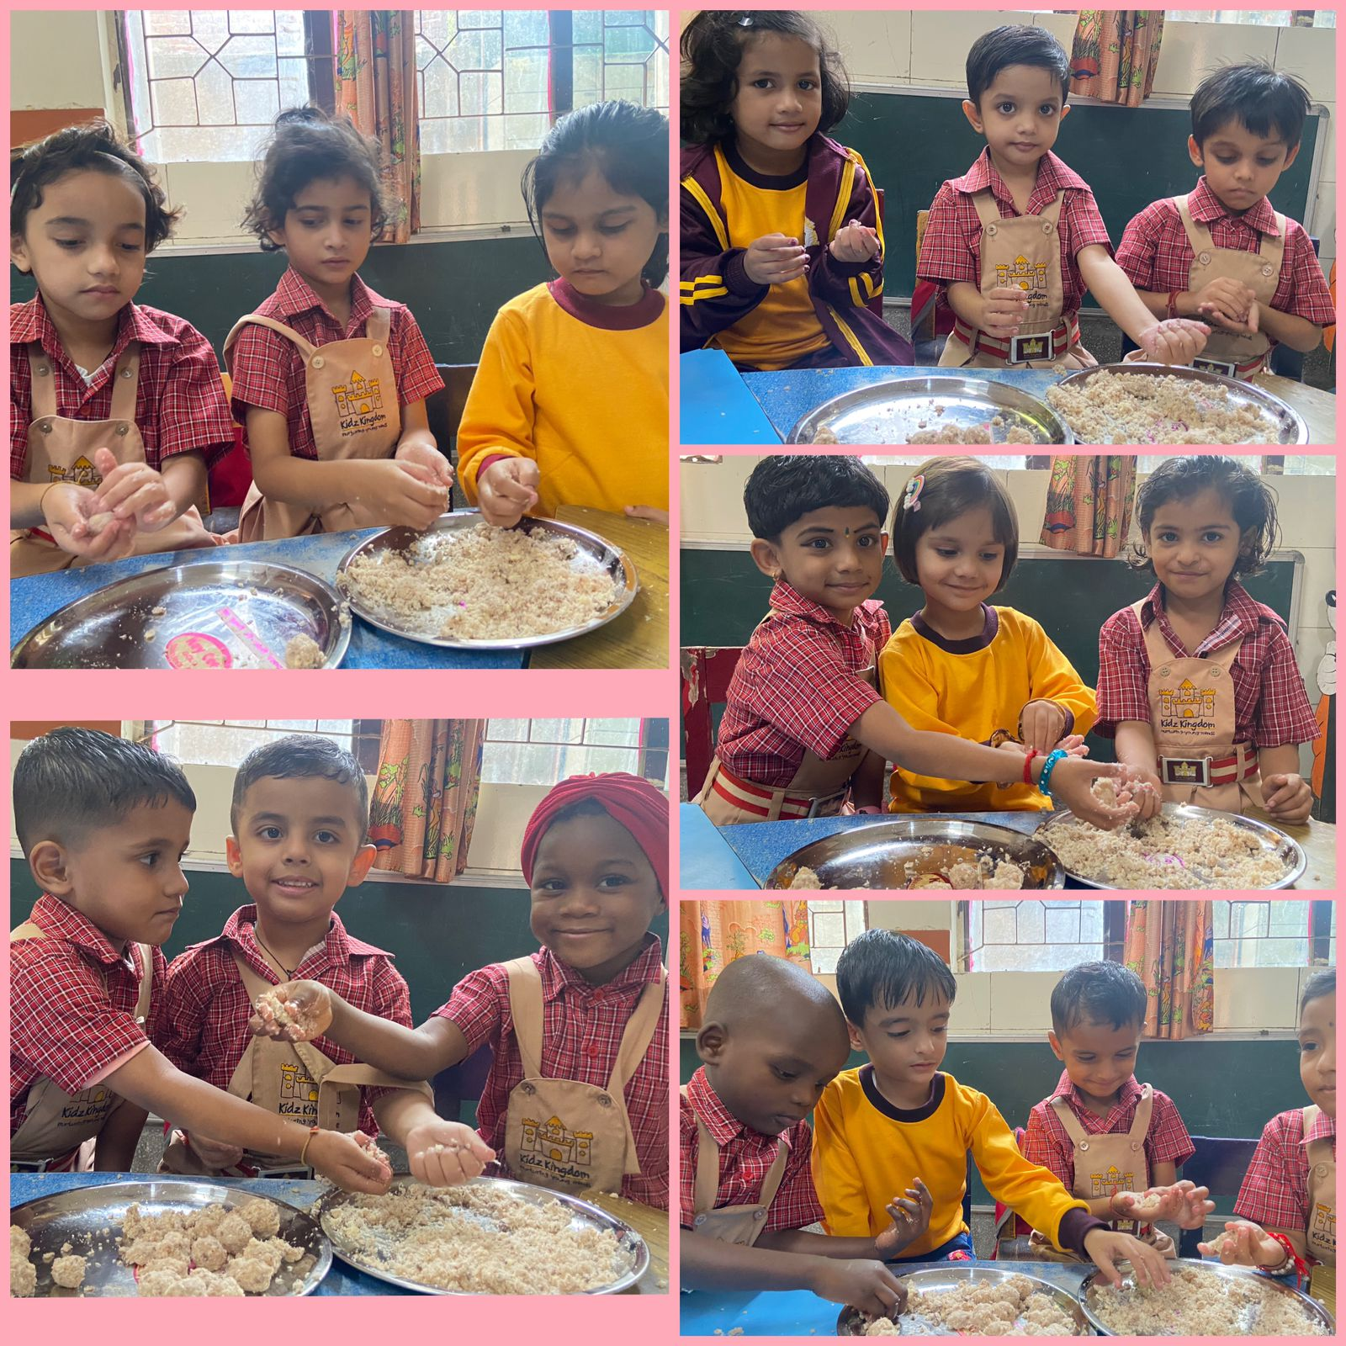
S
LITTLE CHEFS MAKING CHOCOLATE LADOOS
.
MY PROBLEM ISN’T THAT I HAVE A SWEET
TOOTH. IT’S THAT I SEVERAL OF THEM

Slide 8
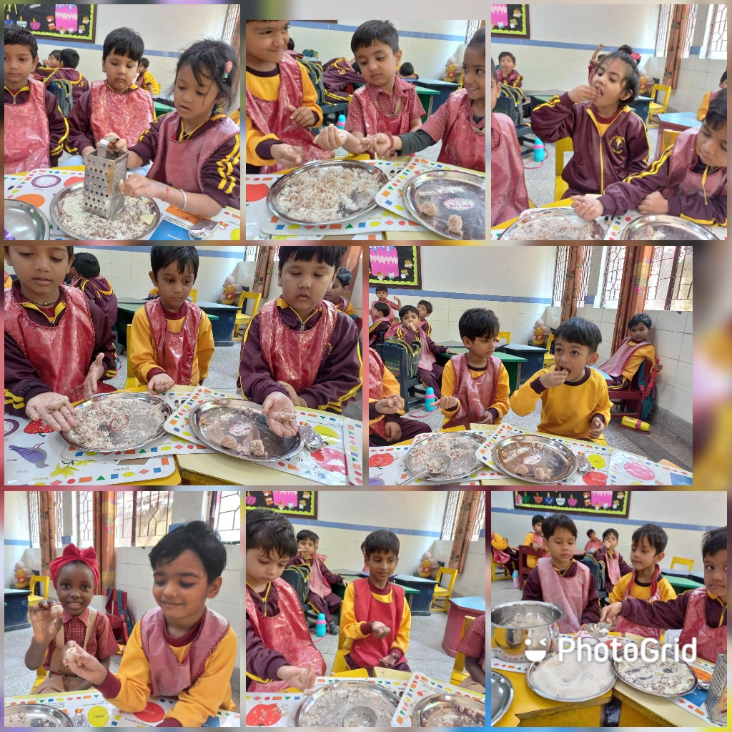
S
.

Slide 9
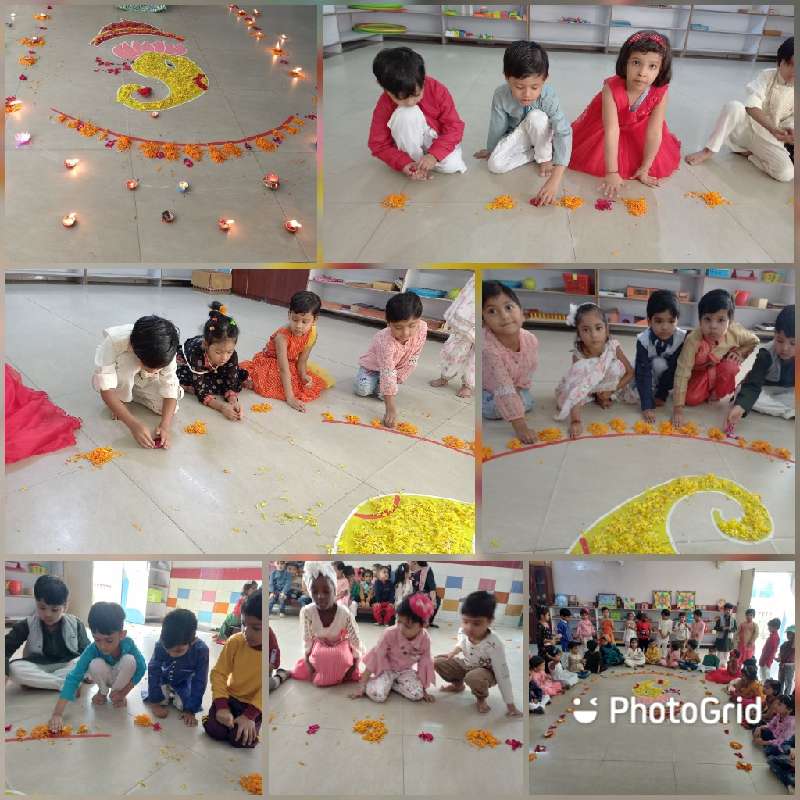
S
Diwali clebrations
.

Slide 10
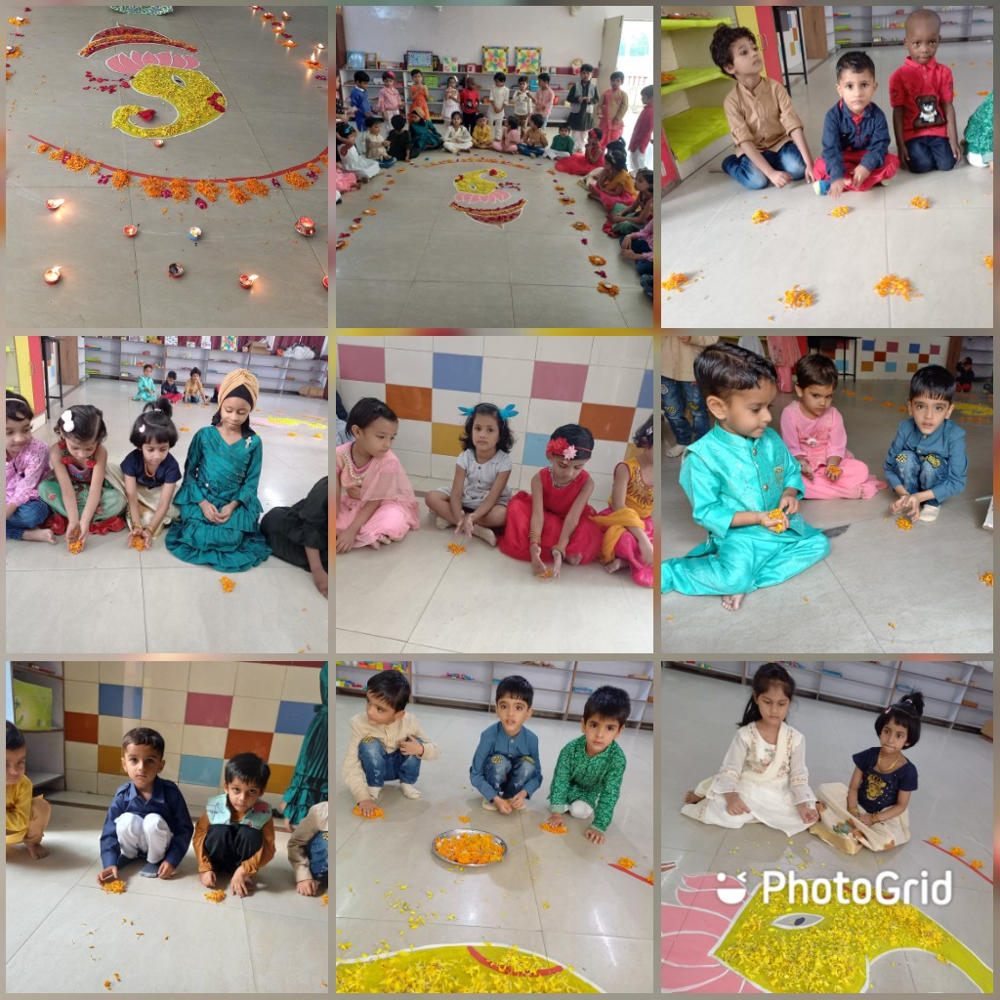
S
.

Slide 11
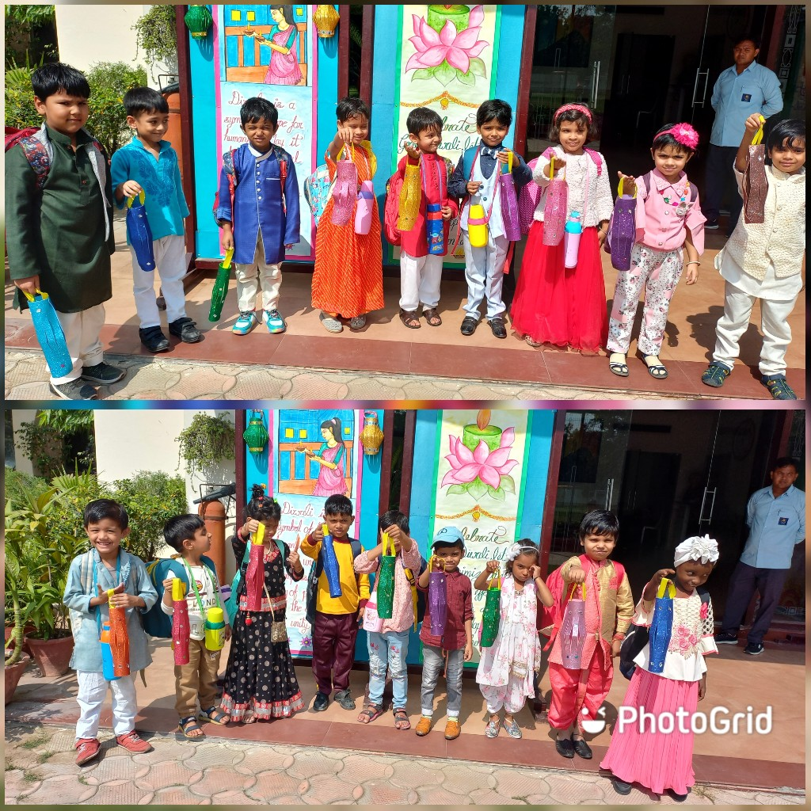
S
.

Slide 12
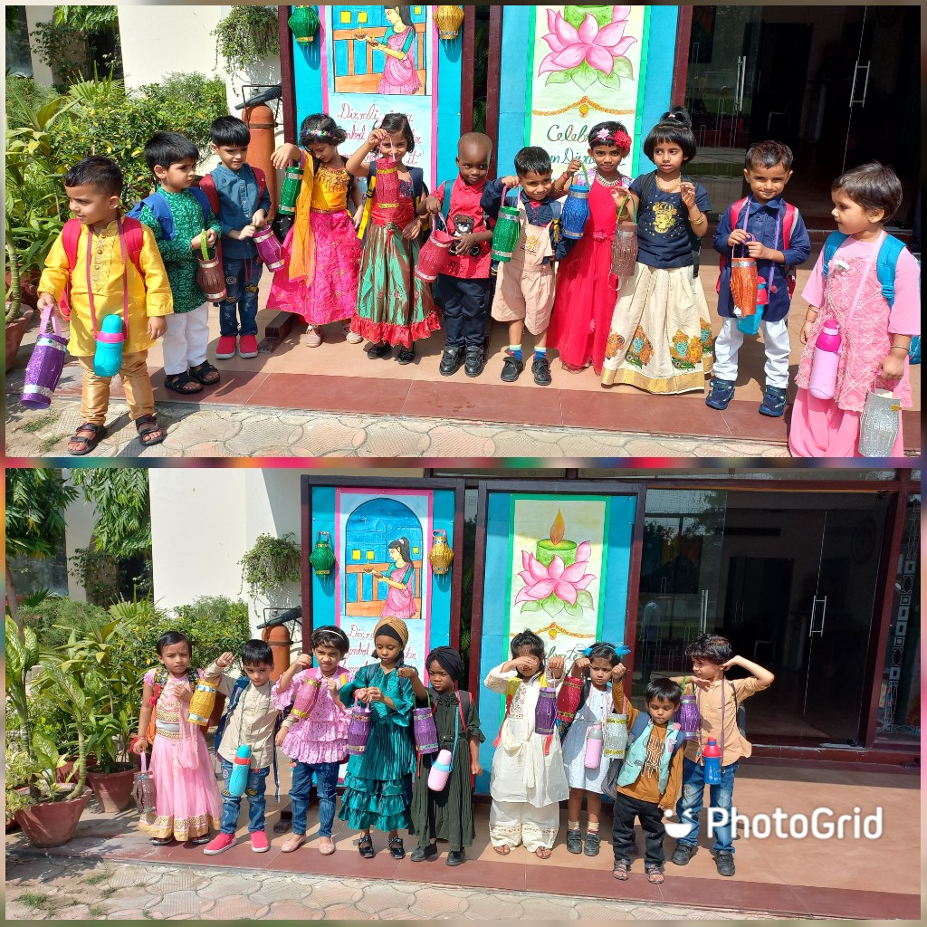
S
.

Slide 13
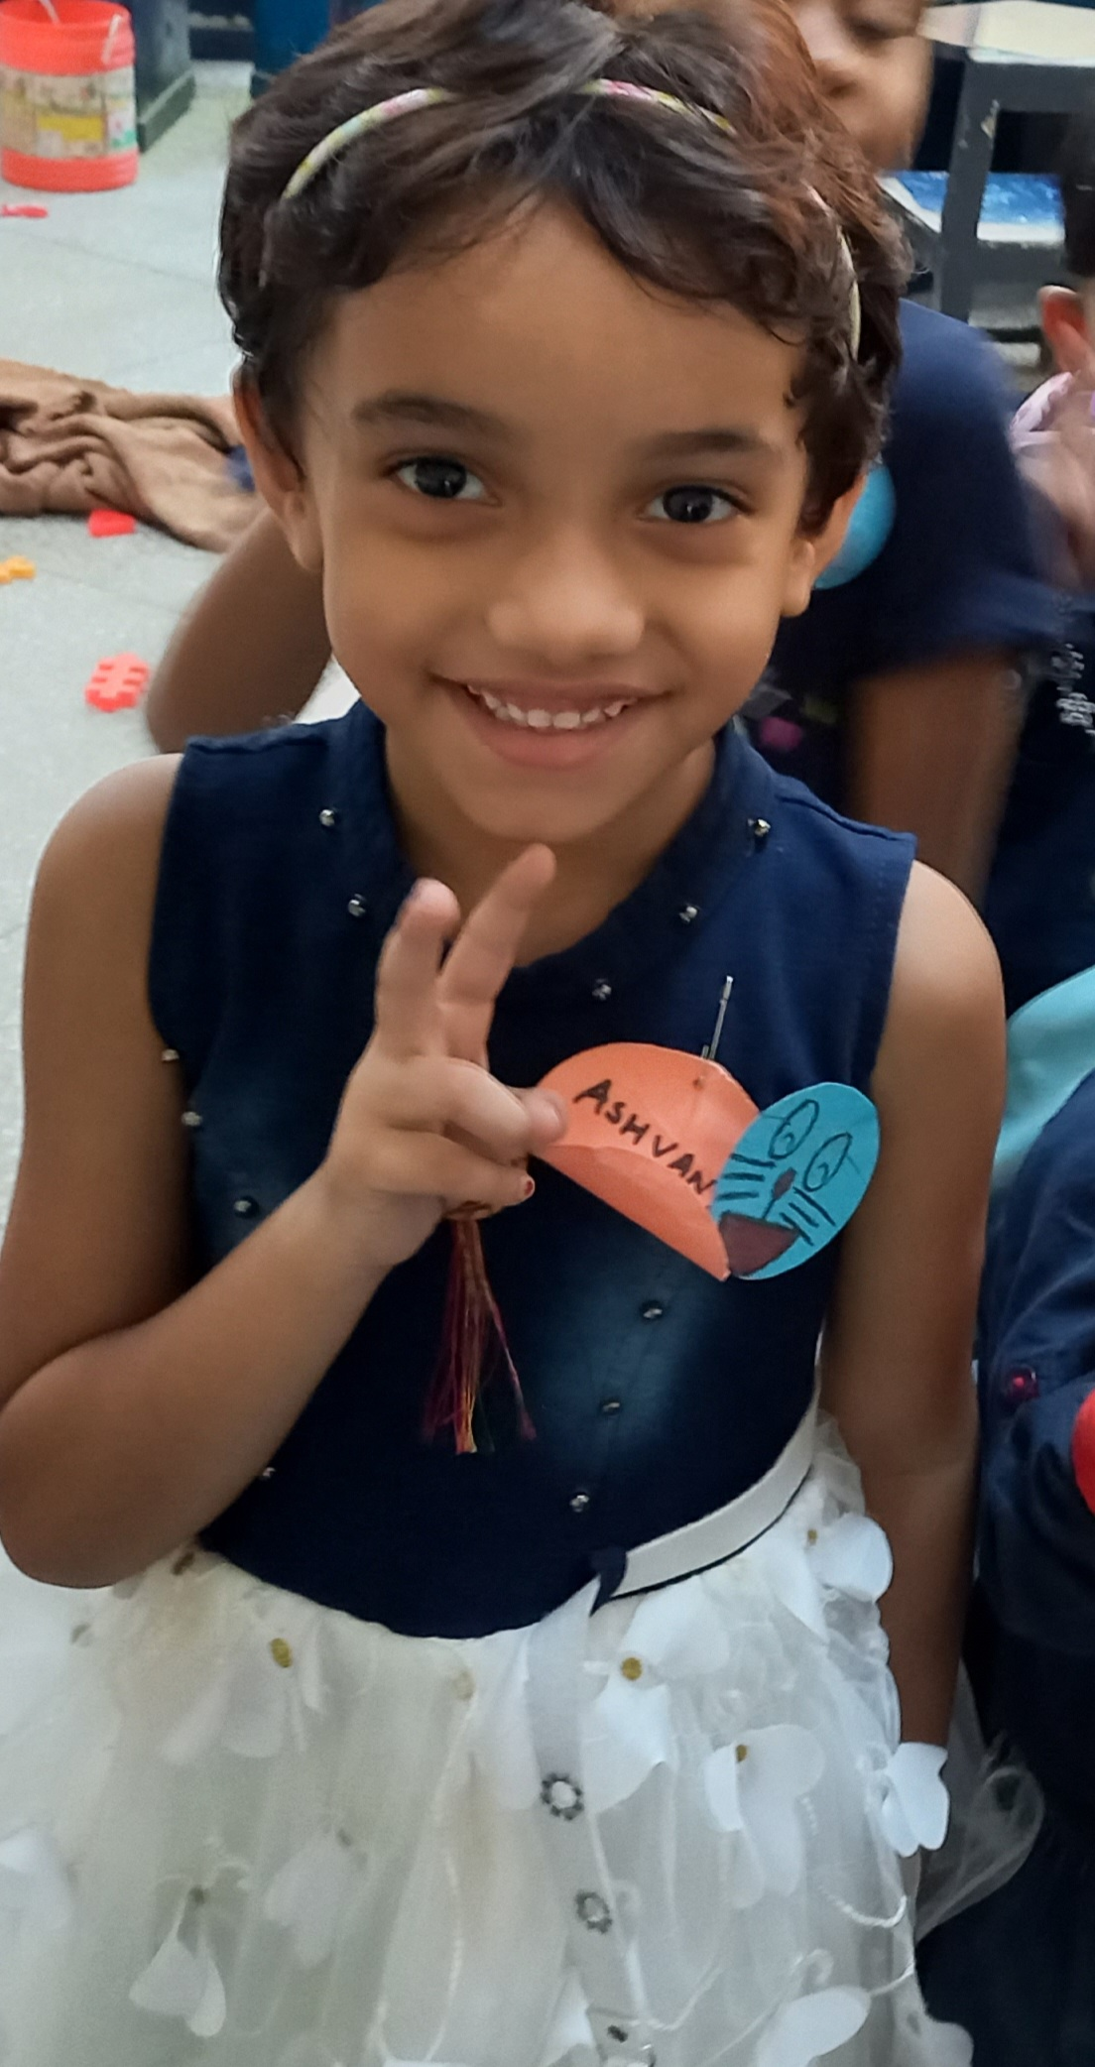
s
BIRTHDAY WISHES FROM HOPE HALL FAMILY TO ASHWANYA
MAY YOU LIVE LONG

Slide 14
KIDKI
PARENTING TIP
KIDS ARE LIKE A
MIRROR,
WHAT THEY SEE
AND
HEAR
THEY DO.
BE A GOOD
REFLECTION TO
THEM

